Slide 1
Distributed Databases

Slide 2
DBMS ARCHITECTURE

Slide 3
CLIENT/SERVER DBMS
Manages user interface
Accepts user data
Processes application/business logic
Generates database requests (SQL)
Transmits database requests to server
Receives results from server
Formats results according to application logic
Present results to the user
CLIENT PROCESS

Slide 4
CLIENT/SERVER DBMS
Accepts database requests
Processes database requests
Performs integrity checks
Handles concurrent access
Optimises queries
Performs security checks
Enacts recovery routines
Transmits result of database request to client
SERVER PROCESS

Slide 5
Centralized client server DBMS on a Network
Site 1
Site 2
Site 5
Communication
Network
Site 4
Site 3

Slide 6



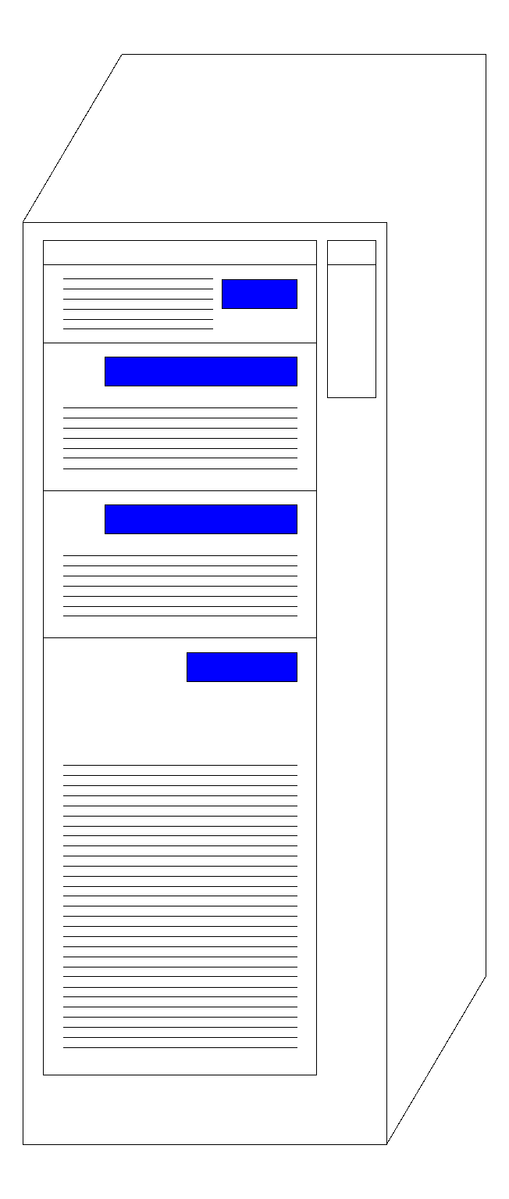

CLIENT/SERVER
DBMS ARCHITECTURE
CLIENT#1
①
SERVER
CLIENT#2
①
②
D/BASE
NETWORK
②
DBMS
CLIENT#3
①
②
DATA LOGIC
PRESENTATION LOGIC
BUSINESS LOGIC
① Data Request
② Data Response
FAT CLIENT
Notes:
‹#›

Slide 7
CLIENT/SERVER
DBMS ARCHITECTURE
CLIENT#1
①
SERVER
CLIENT#2
①
②
D/BASE
NETWORK
PL/SQL
②
DBMS
CLIENT#3
①
②
BUSINESS LOGIC
DATA LOGIC
PRESENTATION LOGIC
(THIN CLIENT)
① Data Request
② Data Response
Notes:
‹#›

Slide 8
Advantages:
Data integrity is maximized.
Data redundancy is minimised as the single storing place of all the data also implies that a given set of data only has one primary record.
This aids in the maintaining of data as accurate and as consistent as possible .
Generally bigger as the single data storage location implies only a on data securityGenerally bigger as the single data storage location implies only a on data securitye possible place from which the database can be attacked and sets of data can be stolen or tampered with.

Slide 9
Easier for using by the end-user due to the simplicity of having a single database design.
Easier data portabilityEasier data portability and database administration.
More cost effective than other types of database systems as labour, power supply and maintenance costs are all minimised.
Data kept in the same location is easier to be changed, re-organised, mirrored, or analysed.
All the information can be accessed at the same time from the same location.
Updates to any given set of data are immediately received by every end-user.

Slide 10
Advantages:
Data integrity is maximized.
Data redundancy is minimized.
Easier data portabilityEasier data portability and database administration.
Simple to design and implement
Cost effective

Slide 11
Disadvantages:
Centralized databases are highly dependent on network connectivity. The slower the internet connection is, the longer the database access time needed will be.
Bottlenecks can occur as a result of high traffic.
Limited access by more than one person to the same set of data as there is only one copy of it and it is maintained in a single location.
This can lead to major decreases in the general efficiency of the system.
If there is no fault-tolerant setup and hardware failure occurs, all the data within the database will be lost.
Since there minimal to none data redundancy, if a set of data is unexpectedly lost it is very hard to retrieve it back, and in most cases it would have to be done manually

Slide 12
Disadvantages:
Availability of data is less.
Not Reliable
Not Scalable
Bottlenecks can occur as a result of high traffic.

Slide 13
DISTRIBUTED DATABASE SYSTEM

Slide 14
Integrate Databases and Commuinication
Database
Technology
Computer
Networks
integration
distribution
Distributed
Database
Systems
integration

Slide 15
Distributed Computing
A number of autonomous processing elements (not necessarily homogeneous) that are interconnected by a computer network and that cooperate in performing their assigned tasks.

Slide 16
What is distributed …
Processing logic
Functions
Data
Control

Slide 17
What is a Distributed Database System?
A distributed database (DDB) is a collection of multiple, logically interrelated databases distributed over a computer network.
A distributed database management system (D–DBMS) is the software that manages the DDB and provides an access mechanism that makes this distribution transparent to the users.
Distributed database system (DDBS) = DB + Communication

Slide 18
Centralized DBMS on a Network
Site 1
Site 2
Site 5
Communication
Network
Site 4
Site 3

Slide 19


M:N CLIENT/SERVER DBMS ARCHITECTURE
SERVER #1
CLIENT#1
D/BASE
DBMS
CLIENT#2
NETWORK
SERVER #2
D/BASE
CLIENT#3
DBMS
NOT TRANSPARENT!
Notes:
‹#›

Slide 20
Distributed DBMS Environment
Site 1
Site 2
Site 5
Communication
Network
Site 4
Site 3

Slide 21
A distributed database is a collection of multiple interconnected databases, which are spread physically across various locations that communicate via a computer network.

Slide 22
Features:
Databases in the collection are logically interrelated with each other.
Often they represent a single logical database.
Data is physically stored across multiple sites.
Data in each site can be managed by a DBMS independent of the other sites.
The processors in the sites are connected via a network.
They do not have any multiprocessor configuration.

Slide 23
A distributed database management system (DDBMS) is a centralized software system that manages a distributed database in a manner as if it were all stored in a single location.

Slide 24
Features
It is used to create, retrieve, update and delete distributed databases.
It synchronizes the database periodically and provides access mechanisms by the virtue of which the distribution becomes transparent to the users.
It ensures that the data modified at any site is universally updated.
It is used in application areas where large volumes of data are processed and accessed by numerous users simultaneously.
It is designed for heterogeneous database platforms.
It maintains confidentiality and data integrity of the databases.

Slide 25
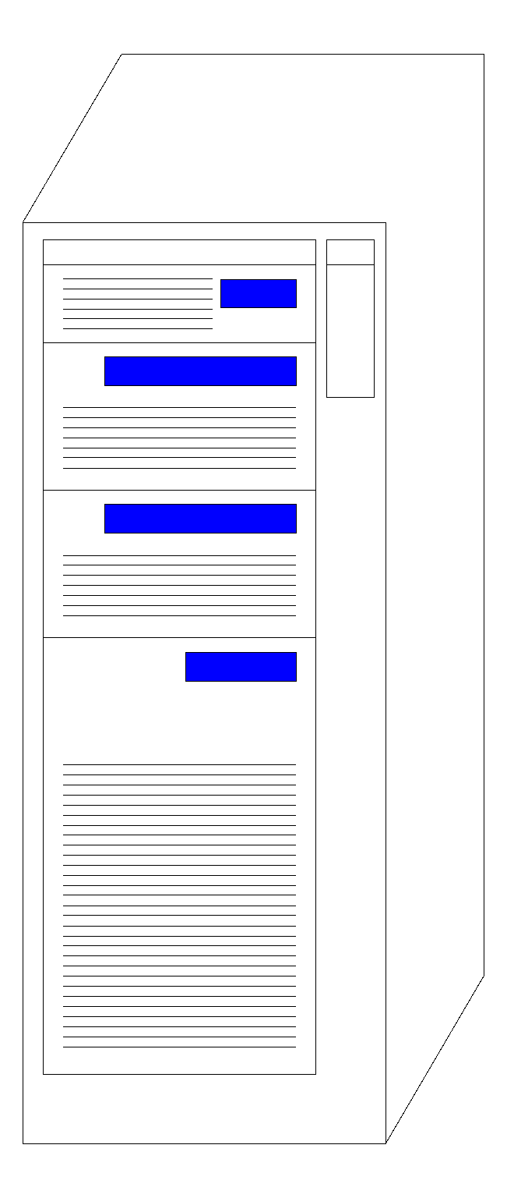

DISTRIBUTED DATABASE ARCHITECTURE
CLIENT
CLIENT
CLIENT
CLIENT
CLIENT
LAN
DBMS
DBMS
CLIENT
CLIENT
CLIENT
CLIENT
WIDE AREA NETWORK
Stratford
Leyton
CLIENT
CLIENT
CLIENT
CLIENT
CLIENT
LAN
DBMS
DBMS
CLIENT
CLIENT
CLIENT
CLIENT
Barking
Leytonstone

Slide 26
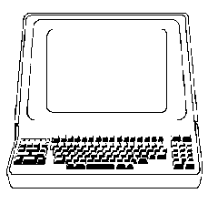

COMPONENTS OF A DDBMS
Site 1
DDBMS
DC
LDBMS
GSC
Computer
DB
Network
GSC
DDBMS
LDBMS = Local DBMS
DC = Data Communications GSC = Global Systems Catalog DDBMS = Distributed DBMS
DC
Site 2

Slide 27
DATA CATALOG:- Describes all data objects stored and managed by the system.
Global catalog: which represents the sum of all data dictionaries within the system.
Approaches:
Completely dispersed: each site has copy of local catalog.
Completely replicated : each site has a complete copy of the entire system catalog.
Centralized Global catalog.

Slide 28
DISTRIBUTED DATABASES
ADVANTAGES
Reduced Communication Overhead
Most data access is local, less expensive and performs
better.
Improved Processing Power
Instead of one server handling the full database, we now
have a collection of machines handling the same database.
Removal of Reliance on a Central Site
If a server fails, then the only part of the system that is
affected is the relevant local site. The rest of the system
remains functional and available.

Slide 29
DISTRIBUTED DATABASES
ADVANTAGES
Expandability
It is easier to accommodate increasing the size of the
global (logical) database.
Local autonomy
The database is brought nearer to its users. This can effect
a cultural change as it allows potentially greater control
over local data .

Slide 30
Advantages of Distributed Databases Following are the various advantages of distributed databases:
Robust–A problem in one part of the organization will not stop other branches working.
Security- Staff access can be restricted to only their portion of databases.
Network traffic is reduced, thus reducing the bandwidth cost.
High Performance–Queries and updates are largely local so that there is no network bottleneck.

Slide 31
Removal of Reliance on a Central Site If a server fails, then the only part of the system that is affected is the relevant local site. The rest of the system remains functional and available.
Expandability
It is easier to accommodate increasing the size of the
global (logical) database.

Slide 32
ADVANTAGE OF DISTRIBUTED DATABASES (contd…)
Increased Reliability and Availability
Reliability – Probability that a system is running at a given time
Availability – Probability that a system is continuously available during a time interval
When the data and the DBMS software are distributed Over several sites ,one site may fail other sites continue to Operate. Only the data and the software that exist at the failed site cannot be accessed. This improves both reliability and availability

Slide 33
Improved Performance
Data Localization – A Distributed database management system fragments the database by keeping the data closer to where it is needed. Data Localization reduces the contention for CPU and I/O services and simultaneously reduces access delays involved in wide area networks.
Easier Expansion- In a Distributed environment , expansion of the system in terms of adding more data, increasing the database sizes or adding more processors is much more easier.

Slide 34
ADVANTAGE OF DISTRIBUTED DATABASES cont
Management of distributed data with different levels of transparency
The user of a distributed system should not be required
To know where the data are physically located or how the data can be accessed at the specific local site. This characteristic is called data transparency. (This refers to the physical placement of data (files, relations, etc.) which is not known to the user (distribution transparency).
Types of transparency:
Distribution or network transparency- Users do not have to worry about operational details of the network.

Slide 35
Location transparency :
Users are not required to know the physical location of the data. The DDBMS should be able to find any data as long as the data identifier is supplied by the user transaction.
(refers to freedom of issuing command from any location without knowing its working).
Location transparency ensures that the user can query on any table(s) or fragment(s) of a table as if they were stored locally in the user’s site.
The fact that the table or its fragments are stored at remote site in the distributed database system, should be completely oblivious to the end user.
The address of the remote site(s) and the access mechanisms are completely hidden.

Slide 36
CREATE PUBLIC SYNONYM emp FOR scott.emp@sales.us.americas.acme_auto.com;
CREATE PUBLIC SYNONYM dept FOR scott.dept@sales.us.americas.acme_auto.com;
SELECT ename, dname
FROM scott.emp@sales.us.americas.acme_auto.com e,
scott.dept@sales.us.americas.acme_auto.com d
WHERE e.deptno = d.deptno;
SELECT ename, dnam FROM emp e, dept d
WHERE e.deptno = d.deptno;

Slide 37
Naming transparency :
DDBMS creates set of aliases for data item. User may refer to this data item by simple name that are translated by the system to complete name.
Mapping of aliases to the real names can be stored on each site. (allows access to any names object (files, relations, etc.) from any location).
Replication transparency- allows to store copies of a data at multiple sites. This is done to minimize access time to the required data.
User is unaware of the existence of multiple copies
User views each data object as logically unique.
The distributed system may replicate an object to increase either system performance or data availability.
System should determine which replica to reference on a read request and should update all replicas on a write request.

Slide 38
Fragmentation transparency-Allows to fragment a relation horizontally (create a subset of tuples of a relation) or vertically (create a subset of columns of a relation).
Fragmentation transparency enables users to query upon any table as if it were unfragmented.
Thus, it hides the fact that the table the user is querying on is actually a fragment or union of some fragments.
It also conceals the fact that the fragments are located at diverse sites.
This is somewhat similar to users of SQL views, where the user may not know that they are using a view of a table instead of the table itself.
User are not required to how a relation has been fragmented.
Horizontal fragmentation
Vertical fragmentation

Slide 39
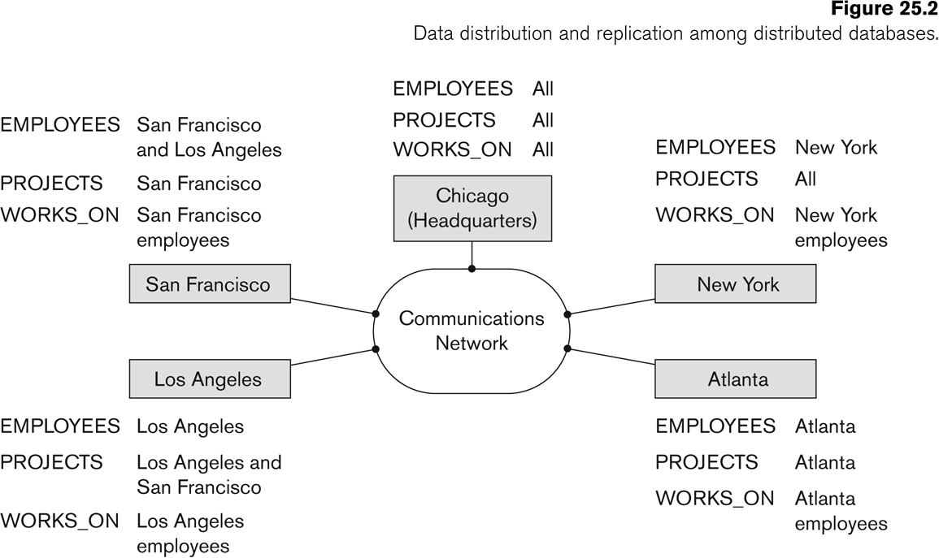

Slide 40
Disadvantages of Distributed Databases Following are the various disadvantages of distributed databases :
Complexity-A distributed database is more complicated to setup and maintain as compared to central database system.
Security–There are many remote entry points to the system compared to central system leading to security threats.
Data Integrity–In distributed system it is very difficult to make sure that data and indexes are not corrupted.
Distributed databases are not so efficient if there is heavy interaction between sites

Slide 41
Disadvantages of DDBMSs
Not Cost effective.
Integrity control more difficult
Lack of standards
Lack of experience
Database design more complex
‹#›

Slide 42
FUNCTIONS OF DDBs
Keeping track of data
Ability to keep track of data distribution
Distributed query processing
Ability to access remote sites and transmit queries
Distributed transaction management
Ability to devise execution strategies for queries and transactions that access data from more than one site
Synchronize access to distributed data
Maintain integrity of the overall database

Slide 43
ADDITIONAL FUNCTIONS OF DDBs (contd…)
Replicated data management
Ability to decide which copy of the replicated data item to access
Maintain the consistency of copies of a replicated data item
Distributed database recovery
Ability to recover from individual site crashes and failure of communication links

Slide 44
ADDITIONAL FUNCTIONS OF DDBs (contd…)
Security
Proper management of security of the data
Proper authorization/access privileges of users
Distributed directory (catalog) management
Directory contains information about data in the database
Directory may be global for the entire DDB or local for each site

Slide 45
12.3 Introduction
Advantages:
Reflects organizational structure
Improved shareability and
local autonomy
Improved availability
Improved reliability
Improved performance
Economics
Modular growth
Disadvantages:
Complexity
Cost
Security
Integrity control more difficult
Lack of standards
Lack of experience
Database design more complex
Notes:
‹#›

Slide 46
Distributed Database Design(key issues)
DATA FRAGMENTATION, REPLICATION, AND ALLOCATION TECHNIQUES FOR DISTRIBUTED DATABASE DESIGN
Fragmentation: Breaking up the database into logical units called fragments and assigned for storage at various sites.
Data replication: The process of storing fragments in more than one site
Data Allocation: The process of assigning a particular fragment to a particular site in a distributed system.
The information concerning the data fragmentation, allocation and replication is stored in a global directory.

Slide 47
Fragmentation
What is a reasonable unit of distribution? Relation or fragment of relation?
• Relations as unit of distribution:
– If the relation is not replicated, we get a high volume of remote data accesses.
– If the relation is replicated, we get unnecessary replications, which cause problems in executing updates and waste disk space.
– Might be an Ok solution, if queries need all the data in the relation and data stays at the only sites that uses the data.

Slide 48
• Fragments of relation as as unit of distribution:
– Application views are usually subsets of relations
– Thus, locality of accesses of applications is defined on subsets of relations.
– Permits a number of transactions to execute concurrently, since they will access different portions of a relation.
– Parallel execution of a single query (intra-query concurrency)
– However, semantic data control (especially integrity enforcement) is more difficult
⇒ Fragments of relations are (usually) the appropriate unit of distribution.

Slide 49
DATA FRAGMENTATION
Breaking up the database into logical units called fragments and assigned for storage at various sites.
Types of Fragmentation
Horizontal Fragmentation
Primary Horizontal
Derived Horizontal
Vertical Fragmentation
Mixed (Hybrid) Fragmentation

Slide 50
Why fragmentation?
Usage
Applications work with views rather than entire relations. Application can have only required data.
Efficiency
Data is stored close to where it is most frequently used.
Data that is not needed by local applications is not stored.
‹#›

Slide 51
Parallelism
With fragments as unit of distribution, transaction can be divided into several subqueries that operate on fragments.
Security
Data not required by local applications is not stored and so not available to unauthorized users.
‹#›

Slide 52
Reasons for Fragmentation
A relation is not an appropriate unit of distribution.
Application views are usually subsets of relations.
Unnecessarily high volume of remote data access
Unnecessary replication

Slide 53
Fragmentation aims to improve:
– Reliability
– Performance
– Balanced storage capacity and costs
– Communication costs
– Security
• The following information is used to decide fragmentation:
– Quantitative information: frequency of queries, site, where query is run, selectivity of queries, etc.
– Qualitative information: types of access of data, read/write, etc.

Slide 54
Disadvantages
Performance.
applications defined on more than one fragments:
performance degradation by union or join.
Integrity.
integrity checking is very difficult
‹#›

Slide 55
Correctness of Fragmentation
Three correctness rules:
Completeness,
Reconstruction,
Disjointness.
‹#›

Slide 56
Correctness of Fragmentation
Completeness
If relation R is decomposed into fragments R₁, R₂, ... R_{n}, each data item that can be found in R must appear in at least one fragment.
Reconstruction
Must be possible to define a relational operation that will reconstruct R from the fragments R₁,R₂,……_{Rn}.
Reconstruction for horizontal fragmentation is done by using Union operation and in Vertical fragmentation Join operation is used for reconstruction. .
‹#›

Slide 57
Correctness of Fragmentation
Disjointness
If data item d_{i} appears in fragment R_{i}, then it should not appear in any other fragment.
Exception: vertical fragmentation, where primary key attributes must be repeated to allow reconstruction.
For horizontal fragmentation, data item is a tuple.
For vertical fragmentation, data item is an attribute.
‹#›

Slide 58
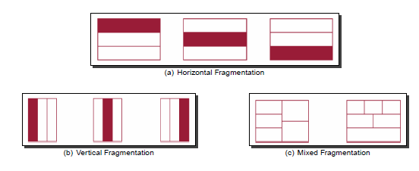
Types of Fragmentation
– Horizontal: partitions a relation along its tuples
– Vertical: partitions a relation along its attributes
– Mixed/hybrid: a combination of horizontal and vertical fragmentation

Slide 59
Fragmentation
Fragmentation involves breaking a relation (table) into two or more pieces either horizontally (Horizontal Fragmentation) or vertically (Vertical Fragmentation) or both (Hybrid), mainly to improve the availability of data to the end user and end user programs.
Fragmentation is the task of dividing a table into a set of smaller tables.
The subsets of the table are called fragments. Fragmentation can be of three types: horizontal, vertical, and hybrid (combination of horizontal and vertical).
Horizontal fragmentation can further be classified into two techniques:
primary horizontal fragmentation and derived horizontal fragmentation.

Slide 60
CASE STUDY
Consider XYZ bank, which is currently having around 1000 branches all over the country. Assume that it maintains its database at single location, say New Delhi (Head office - Central Site). Now the problem is that, all the requests generated from any part of the country can only be handled at the central site (New Delhi). The requests might be generated for withdrawal of money, balance inquiry, PIN change request, transfer of funds, POS purchase, etc., through ATM, Net Banking, POS terminals. Think about the number of transactions could be generated and the network traffic created if thousands of the bank customer uses the above said mode for daily transactions, including direct bank transactions at the bank counters.

Slide 61
One possible solution for handling such a huge number of transactions is to have distributed database.
But, we have set of questions in front of us. They are;
How are we going to fragment a table?
How many fragments to be created?
Which strategy of fragmentation would help improving the performance?
Should one need to fragment all the tables in a database or only a few tables?
Where do we keep the fragments after fragmentation? (Allocation problem)

Slide 62
Types of Fragmentation: The first question 'How are we going to fragment a table?' can be answered here. We have the following types of fragmentation.
Horizontal Fragmentation
Vertical Fragmentation
Hybrid Fragmentation.

Slide 63
1. Horizontal Fragmentation: A relation (table) is partitioned into multiple subsets horizontally using simple conditions.
Fragment, R_{i} = σ_{Fi}(R), 1 ≤ i ≤ n Let us take a relation of schema Account(Acno, Balance, Branch_Name, Type). If the permitted values for Branch_Name attribute are 'New Delhi', 'Chennai', and 'Mumbai', then the following SQL query would fragment the bunch of tuples (records) satisfying a simple condition.
SELECT * FROM account WHERE branch_name = 'Chennai';

Slide 64
this query would get you all the records pertaining to the 'Chennai' branch, without any changes in the schema of the table. We could get three such bunch of records if we change the branch_name value in the WHERE clause of the above query, one for 'Chennai', one for 'New Delhi', and one for 'Mumbai'.
This way of horizontally slicing the whole table into multiple subsets without altering the table structure is called Horizontal Fragmentation.
The concept is usually used to keep tuples (records) at the places where they are used the most, to minimize data transfer between far locations.

Slide 65
Horizontal Fragmentation has two variants as follows;
Primary Horizontal Fragmentation (PHF)
Derived Horizontal Fragmentation (DHF)
1.1 Primary Horizontal Fragmentation (PHF) Primary Horizontal Fragmentation is about fragmenting a single table horizontally (row wise) using a set of simple predicates (conditions) on owner table.
Fragmentation on Primary relation is called PHF.
Fragment, R_{i} = σ_{Fi}(R), 1 ≤ i ≤ n(Fi is a minterm predicate or simple predicate).

Slide 66
What is simple predicate?
Given a table R with set of attributes [A₁, A₂, …, A_{n}], a simple predicate P_{i} can be expressed as follows;
P_{i} : A_{j} θ Value
Where θ can be any of the symbols in the set {=, <, >, ≤, ≥, ≠}, value can be any value stored in the table for the attributed A_{i}.

Slide 67
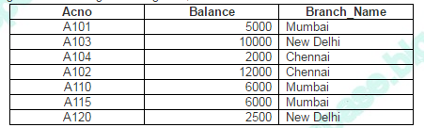
For example, consider the following table Account
Account:
What is set of simple predicates?
Set of simple predicates is set of all conditions collectively required to fragment a relation into subsets. For a table R, set of simple predicate can be defined as.
P = { P₁, P₂, …, P_{n}}

Slide 68
Example 1 As an example, for the above table Account, if simple conditions are, Balance < 10000, Balance ≥ 10000, then,
Set of simple predicates P1 = {Balance < 10000, Balance ≥ 10000}
Example 2 As another example, if simple conditions are, Branch_name = ‘Chennai’, Branch_name= ‘Mumbai’, Balance < 10000, Balance ≥ 10000, then,
Set of simple predicates P2 = { Branch_name = ‘Chennai’, Branch_name= ‘Mumbai’, Balance < 10000, Balance ≥ 10000}

Slide 69
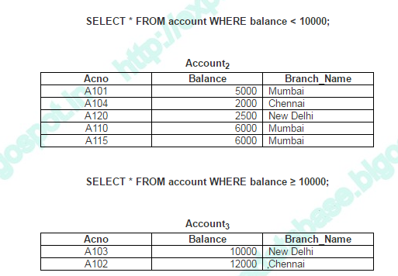

Slide 70
What is Min-term Predicate?
When we fragment any relation horizontally, we use single condition, or set of simple predicates to filter the data.
Given a relation R and set of simple predicates, we can fragment a relation horizontally as follows (relational algebra expression);
Fragment, R_{i} = σ_{Fi}(R), 1 ≤ i ≤ n
Simple predicates represented in conjunctive normal form, called as Min-term predicate which can be written as follows;
Min-term predicate, M_{i}=P₁ Λ P₂ Λ P₃ Λ … Λ P_{n}

Slide 72
Set of simple predicates P = { Branch_name = ‘Chennai’, Branch_name= ‘Mumbai’, Balance < 10000, Balance ≥ 10000}
Min term predicate:
{Branch_name = ‘Chennai’ Λ Balance < 10000, Branch_name = ‘Chennai’ Λ Balance ≥ 10000, Branch_name = ‘Mumbai’ Λ Balance < 10000,
Branch_name = ‘Mumbai’ Λ Balance ≥ 10000,} R1= σ Branch_name = ‘Chennai’ Λ Balance < 10000(Account)
R2= σ Branch_name = ‘Chennai’ Λ Balance >= 10000(Account)
R3= σ Branch_name = ‘Mumbai’ Λ Balance < 10000(Account)
R4= σ Branch_name = ‘Mumbai’ Λ Balance >= 10000(Account)
Not Complete.Why?

Slide 73
R1= σ Branch_name = ‘Chennai’ Λ Balance < 10000(Account)
R2= σ Branch_name = ‘Chennai’ Λ Balance >= 10000(Account)
R3= σ Branch_name = ‘Mumbai’ Λ Balance < 10000(Account)
R4= σ Branch_name = ‘Mumbai’ Λ Balance >= 10000(Account)
R5= σ Branch_name = ‘Delhi’ Λ Balance >= 10000(Account)
R6= σ Branch_name = ‘Delhi’ Λ Balance >= 10000(Account)
Complete Fragmentation.

Slide 74
Steps in Horizontal Fragmentation:
The following information is used to decide fragmentation:
– Quantitative information: frequency of queries, site, where query runs, selectivity of queries, etc.
– Qualitative information: types of access of data, read/write, etc.
Identify Predicate
Identify Min term Predicate
Create separate fragment for every min term predicate.
Check correctness criteria.

Slide 75
Correctness criteria for Horizontal Fragmentation
Complete Horizontal Fragmentation(Completeness)
Set of horizontal fragments that include all the tuples in a relation
Reconstruction: To reconstruct a relation, apply the UNION operation to the horizontal fragments.
If a relation R is horizontally decomposed into fragments R1,R2 …. Rn, then reconstruct R 🡨 R1 U R2 U …Rn.
Disjointness
If a relation R is horizontally decomposed into fragments R₁,R₂…. R_{n}, and data item d_{i} is in R_{j}, it is not in any other fragment Rk (k != j).

Slide 76
Derived Horizontal Fragmentation
A derived horizontal fragmentation is defined on a member relation of a link according to a selection operation specified on its owner
Fragmentations of the secondary relations that are dependent on the primary relation.
Fragmentation of owner or primary relation causes fragmentation of member relation is called Derived horizontal fragmentation.
It is important to remember two points
First, the link between the owner and the member relations is defined as an equi-join
Second, an equi-join can be implemented by means of semi-join

Slide 77
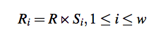
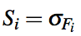
Derived Horizontal Fragmentation
Accordingly, given a link L where owner(L) = S and member(L) = R, the derived horizontal fragments of R are defined as:
Where w is the maximum number of fragments that will be defined on R, and
where Fi is the formula according to which the primary horizontal fragment Si is defined
S

Slide 78
Semi-Join
The semi-join of relation R, defined over the set of attributes A, by relation S, defined over the set of attributes B, is the subset of the tuples of R that participate in the join of R with S.

Slide 79
Derived Horizontal Fragmentation
To carry out a derived horizontal fragmentation, three inputs are needed:
The set of partitions of the owner relation (PAY1, PAY2)
The member relation
The set of semi join predicates between the owner and member (EMP.TITLE=PAY.TITLE)

Slide 80
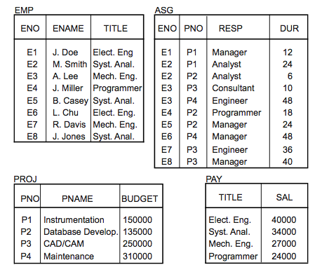

Slide 81
Title | Salary
Owner Relation
PAY
Empno | Empname | Tiltle
Member Relation
Emp

Slide 82
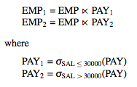
Example
Consider L1, where owner(L1) = PAY and member (L1) = EMP
We can group engineers into two groups according to their salary: those making less then or equal to $30,000, and those making more then $30,000
The two fragments EMP1 and EMP2 are defined as:

Slide 83
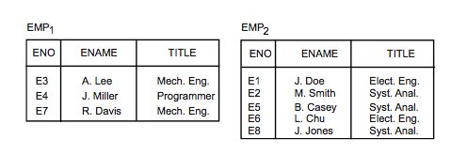
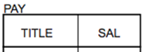
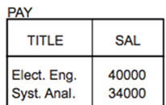
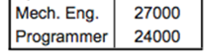
Example
1
2

Slide 84
Correctness criteria for Derived Fragmentation:
Completeness:
Let R be the member relation of link whose owner relation S is fragmented as Fs={s1,s2,s3……..sn}.Let A be the Join(Common) Attribute between R and S. Then for each tuple of R there should be a tuple t’ in S such that t[A]=t’[A].
Ensure referential integrity .
Derived fragmentation on member relation will be complete as long as primary horizontal fragmentation of owner relation is complete.

Slide 85
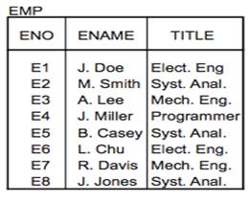
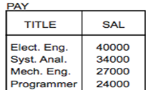
Reconstruction
U
DHF
PHF
U
1
2

Slide 86
Reconstruction:
Reconstruction of Global relation from its fragments is done by applying Union operation on primary horizontal as well as
Derived horizontal fragments.
Disjointness:
Disjointness is guaranteed as long as the predicates determining fragmentation are mutually exclusive.

Slide 87
VERTICAL FRAGMENTATION
Vertical fragmentation refers to the division of a relation into attribute (column) subsets.
Each subset (fragment) is stored at a different node, and each fragment has unique columns—with the exception of the key column, which is common to all fragments.
This is the equivalent project (Π) operation in relational Algebra.
A vertical fragment keeps only certain attributes of that relation
Divides a relation vertically by columns.
It is necessary to include primary key or some candidate key attribute
The full relation can be reconstructed from the fragments using join.

Slide 88
Definition
Vertical Fragmentation Partitions R to fragments R1, R2, …, Rr, each of which contains a subset of R’s attribute as well as the primary key of R.
A vertical fragment on a relation can be specified by a Π_{Li}(R) operation in the relational algebra.
R_{i =} Π_{Li}(R) where w>=i>1
_{Li} : list of attributes from R.
_{W} : number of fragments.

Slide 89
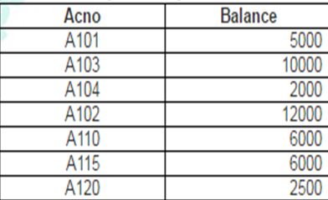
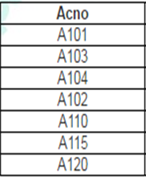
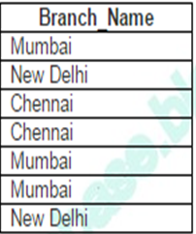
Example Account:
Vertical Fragmentation:
Account1= Π_{acno,balance} (Account)
Account2= Π_{acno,branch_name} (Account)
Account1
Account2

Slide 90
Id | Name | Sal | Dept
100 | A | 10K | D1
200 | B | 20K | D2
300 | C | 30K | D3
Example Used Table Name :Employee
Vertical Fragmentation
Columns split : Primary Key retained
Id | Name
100 | A
200 | B
300 | C
Id | Sal | Dept
100 | 10K | D1
200 | 20K | D2
300 | 30K | D3

Slide 91
Correctness criteria for Vertical fragmentation:
Completeness:
A set of vertical fragments whose projection lists L1, L2, …, Ln include all the attributes in R but share only the primary key of R.
In this case the projection lists satisfy the following two conditions:
L1 ∪ L2 ∪ ... ∪ Ln = ATTRS (R)
Li ∩ Lj = PK(R) for any i j, where ATTRS (R) is the set of attributes of R and PK(R) is the primary key of R.
Reconstruction:
To reconstruct R from complete vertical fragments a OUTER Join (Join)is applied.
Disjointnes:
R1 ∩R2 ∩R3…..Rn=PK(R)

Slide 92
Account
Account1
Account2

Slide 93
Mixed (Hybrid) fragmentation
A combination of Vertical fragmentation and Horizontal fragmentation.
This is achieved by SELECT-PROJECT operations which is represented by Π_{Li}(σ_{Ci} (R)).
If C = True (Select all tuples) and L ≠ ATTRS(R), we get a vertical fragment, and if C ≠ True and L ≠ ATTRS(R), we get a mixed fragment.
If C = True and L = ATTRS(R), then R can be considered a fragment.
Slide 25- ‹#›
Notes:
‹#›

Slide 94
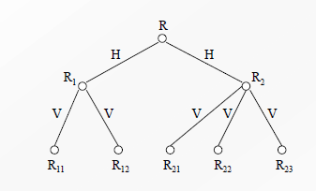

Slide 95
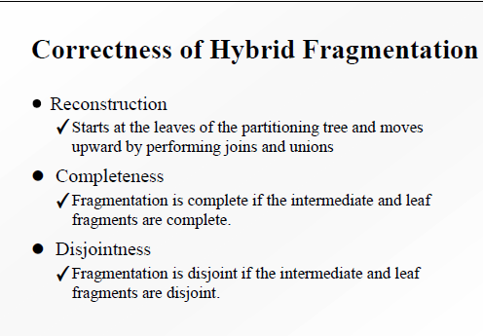

Slide 96
Consider the following database that has to be distributed:
Patient(Number,Name,SSN,Amount_Due,Dept,Doctor,Med_treatment)
Department(Dept,Location,Director)
Staff(Staffnum,Director,Task)
Show 2 examples of horizontal fragmentation
Show 2 examples of Vertical fragmentation
Show 1 examples of Derived fragmentation

Slide 97
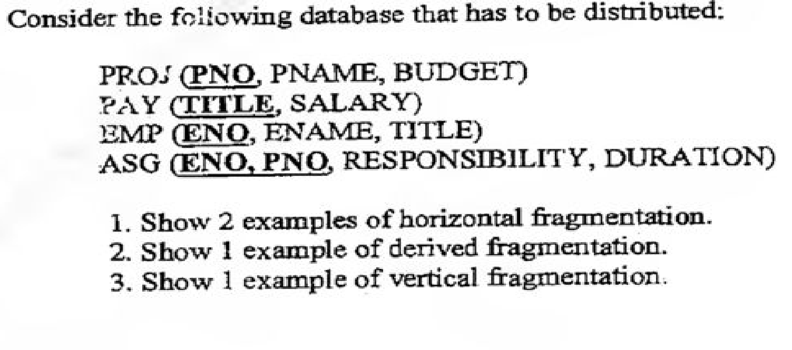

Slide 98
DATA REPLICATION
Process of storing data in more than one site
Replication Schema
Description of the replication of fragments.
Types of Replications:
Fully replicated distributed database
Replicating the whole database at every site
Improves availability
Improves performance of retrieval
Can slow down update operations drastically
Expensive concurrency control and recovery techniques

Slide 99
DATA REPLICATION (contd…)
No replication distributed database
Each fragment is stored exactly at one site
All fragments must be disjoint except primary keys
Also called Non-redundant allocation
Partial Replication
Some fragments may be replicated while others may not
Number of copies range from one to total number of sites in a distributed system

Slide 100
Data Replication (Cont.)
Advantages of Replication
Availability: failure of site containing relation r does not result in unavailability of r is replicas exist.
Parallelism: queries on r may be processed by several nodes in parallel.
Reduced data transfer: relation r is available locally at each site containing a replica of r.
Disadvantages of Replication
Increased cost of updates: each replica of relation r must be updated.
Increased complexity of concurrency control: concurrent updates to distinct replicas may lead to inconsistent data unless special concurrency control mechanisms are implemented.
One solution: choose one copy as primary copy and apply concurrency control operations on primary copy
Notes:
‹#›

Slide 101
Comparison of Replication Alternatives
 | Full Replication | Partial Replication | Partitioning(No replication)
Query Processing | Easy | Same | Difficulty
Directory Management | Easy or nonexistent | Same | Difficulty
Concurrency Control | Moderate | Difficult | Easy
Reliability | Very High | High | Low
Reality | Possible Application | Realistic | Possible application

Slide 102
DATA ALLOCATION
Assigning fragment to particular site is called data allocation.
Also called Data Distribution
Choice of sites and degree of replication depend on
Performance of the system
Availability goals of the system
Types of transactions
Frequencies of transactions submitted at any site
Allocation Schema
Describes the allocation of fragments to sites of the DDBs

Slide 103
Fragment allocation is nothing but placement of data fragment with optimization.
Efficient distribution of fragments requires a balance between costs (storage, processing and transmission of data), performance (especially response time) and data distribution restrictions.
Give: • a set of m fragments F = {F1, F2, ..., Fm} exploited by a set of k applications Q = {Q1, Q2, ..., Qk} on a set of p sites S = {S1, S2, ..., Sp}.
Determine: • Set(F, S) = ( 1 if F is allocated , otherwise 0.)

Slide 104
The allocation problem involves finding the ”optimal” distribution of F to S. To minimize:
• storage cost + communication cost + local processing cost
Subject to:
• response time constraints
• availability constraints
• network topology
• security restrictions

Slide 105
Alternative strategies for placing data
Partitioned
Database partitioned into disjoint fragments
Each fragment assigned to one site
(Complete) Replication
Complete copy of database at each site
Partial replication.

Slide 106
Schemas in Distributed Database:
Fragmentation Schema
Replication Schema
Allocation Schema
Global Schema
Local Schema

Slide 107
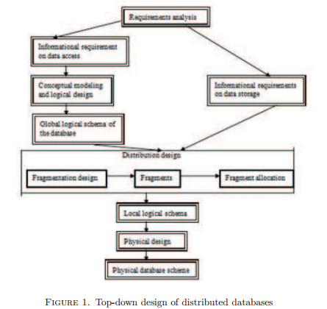
The design of a distributed database

Slide 108
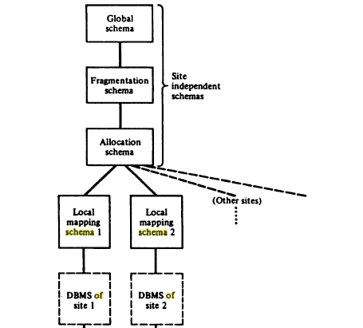
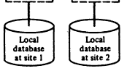

Slide 109
Global schema defines all the data which are contained in the distributed database as if the database is not distributed at all.
Global schema is defined as the same way as that of non distributed database schema.
Global schema consist of collection of global relations.
Global relations can be split into several non overlapping portions which are called fragments.
The mapping between global relation and fragments is called fragmentation schema.
Mapping is one to many from global relation to fragments.
Every fragment is named as global relation followed by index.
Eg. R_{i} i^{th} fragment of global relation R.

Slide 110
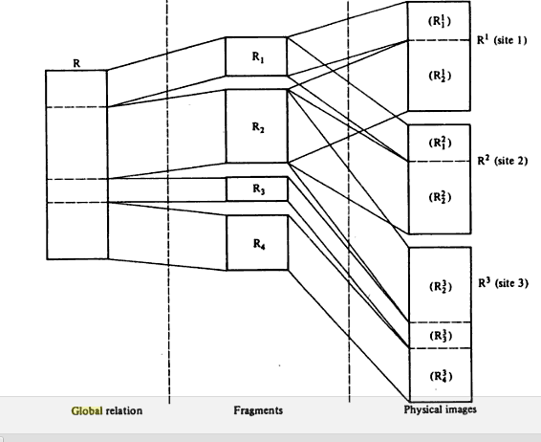

Slide 111
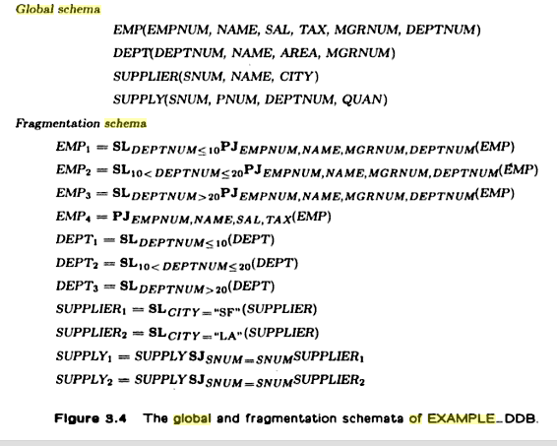

Slide 112
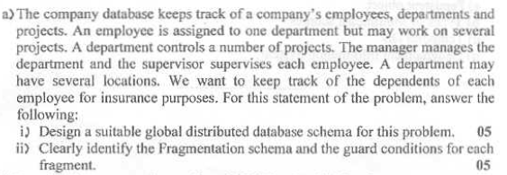

Slide 113
TYPES OF DISTRIBUTED DATABASE SYSTEM

Slide 114
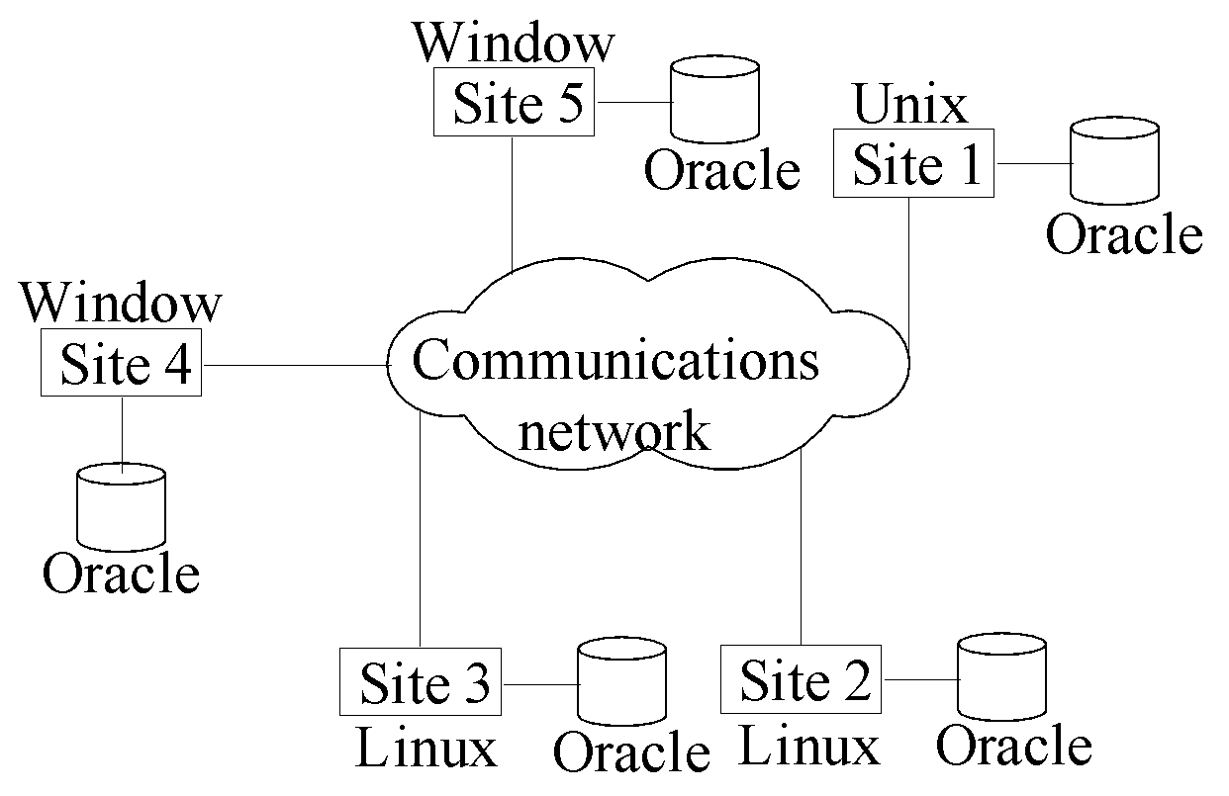
Types of Distributed Database Systems
Homogeneous
All sites of the database system have identical setup.
The underlying operating system may be different.
For example, all sites run Oracle or DB2, or Sybase or some other database system.
The underlying operating systems can be a mixture of Linux, Window, Unix, etc.
Slide 25- ‹#›
Notes:
‹#›

Slide 115
Heterogeneous
In a heterogeneous system, sites may run different DBMS products, which need not be based on the same underlying data model,.
System may be composed of relational, network, hierarchical and object-oriented DBMSs.

Slide 116
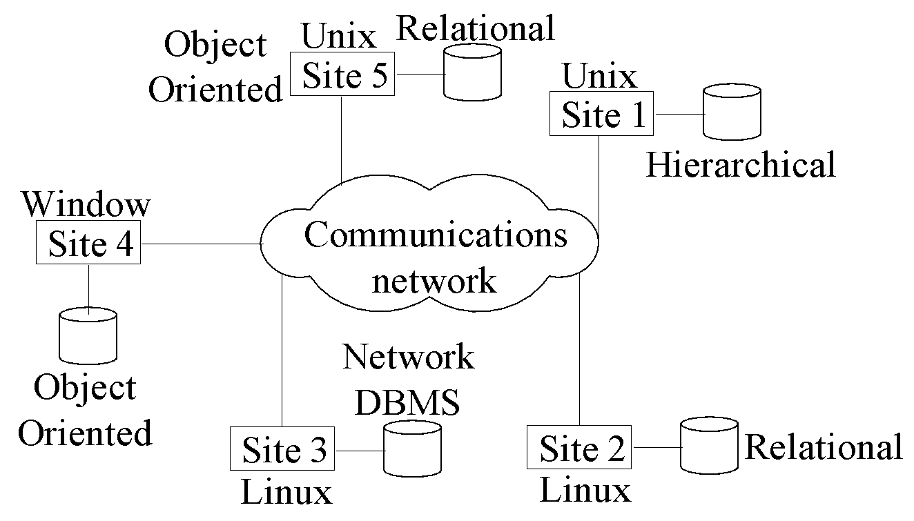
Types of Distributed Database Systems
Heterogeneous
Federated: Each site may run different database system but the data access is managed through a single conceptual schema.
This implies that the degree of local autonomy is minimum. Each site must adhere to a centralized access policy. There may be a global schema.
Multidatabase: There is no one conceptual global schema. For data access a schema is constructed dynamically as needed by the application software.
Slide 25- ‹#›
Notes:
‹#›

Slide 117
Homogeneous Distributed Databases
In a homogeneous distributed database
All sites have identical software
Are aware of each other and agree to cooperate in processing user requests.
Each site surrenders part of its autonomy in terms of right to change schemas or software
Appears to user as a single system
In a heterogeneous distributed database
Different sites may use different schemas and software
Difference in schema is a major problem for query processing
Difference in software is a major problem for transaction processing
Sites may not be aware of each other and may provide only limited facilities for cooperation in transaction processing
Notes:
‹#›

Slide 118
ARCHITECTURAL MODELS FOR DISTRIBUTED DBMSs - DISTRIBUTION
Distributions refers to the distributions of data. Of course, we are considering the physical distribution of data over multiple sites; the user sees the data as one logical pool.
Two alternatives:
client / server distribution
peer-to-peer distribution (full distribution)
‹#›

Slide 119
ARCHITECTURAL MODELS FOR DISTRIBUTED DBMSs - DISTRIBUTION
Client / server distribution.
The client / server distribution concentrates data management duties at servers while the clients focus on providing the application environment including the user interface. The communication duties are shared between the client machines and servers. Client / server DBMSs represent the first attempt at distributing functionality.
Peer-to-peer distribution.
There is no distinction of client machines versus servers. Each machine has full DBMS functionality and can communicate with other machines to execute queries and transactions.
‹#›

Slide 120
DISTRIBUTED DBMS ARCHITECTURE CLIENT / SERVER SYSTEMS
This provides two-level architecture which make it easier to manage the complexity of modern DBMSs and the complexity of distribution.
The server does most of the data management work (query processing and optimization, transaction management, storage management).
The client is the application and the user interface (management the data that is cached to the client, management the transaction locks).
‹#›

Slide 121
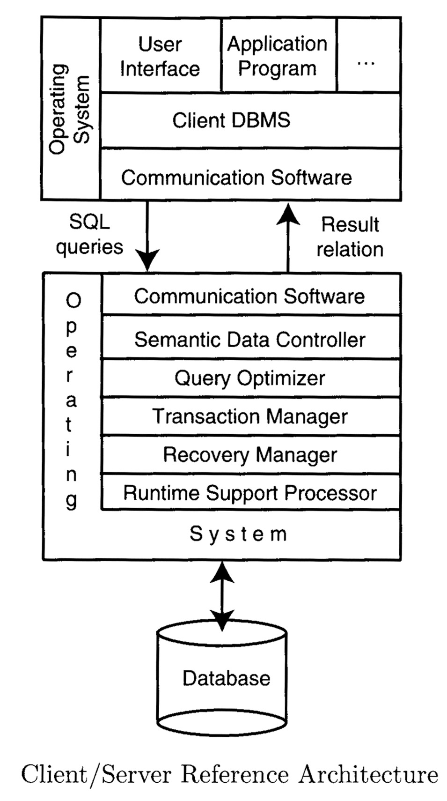
DISTRIBUTED DBMS ARCHITECTURE CLIENT / SERVER SYSTEMS
This architecture is quite common in relational systems where the communication between the clients and the server(s) is at the level of SQL statements.
‹#›

Slide 122
DISTRIBUTED DBMS ARCHITECTURE CLIENT / SERVER SYSTEMS
Multiple client - single server
From a data management perspective, this is not much different from centralized databases since the database is stored on only one machine (the server) which also hosts the software to manage it. However, there are some differences from centralized systems in the way transactions are executed and caches are managed.
Multiple client - multiple server
In this case, two alternative management strategies are possible: either each client manages its own connection to the appropriate server or each client knows of only its “home server” which then communicates with other servers as required.
‹#›

Slide 123
Client-Server architecture
Distinguish the functionality and divide these functions into two classes, server functions and client functions.
Server does most of the data management work
query processing
data management
Optimization
Transaction management etc
Client performs
Application
User interface
DBMS Client model
Multiple Client - Single Server
Single Server accessed by multiple clients
Multiple Client – Multiple Server
Multiple Servers accessed by multiple clients
2 alternate management strategies
Heavy client Systems
Each client manages its own connection to the appropriate server.
Simplifies server code
Loads client machines with additional responsibilities
Light Client Systems
Each client knows of only its “home server” which then communicates with other servers as required.
Concentrates on data management functionality at the servers.

Slide 124
DISTRIBUTED DBMS ARCHITECTURE PEER-TO-PEER DISTRIBUTED SYSTEMS
The physical data organization on each machine may be different.
Local internal scheme (LIS) - is an individual internal schema definition at each site.
Global conceptual schema (GCS) - describes the enterprise view of the data.
Local conceptual schema (LCS) - describes the logical organization of data at each site.
External schemas (ESs) - support user applications and user access to the database.
‹#›

Slide 125
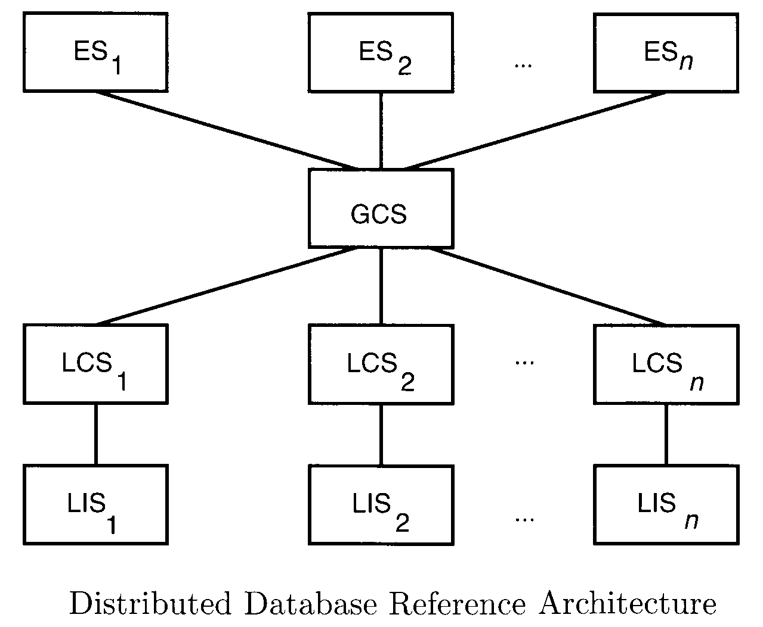
DISTRIBUTED DBMS ARCHITECTURE PEER-TO-PEER DISTRIBUTED SYSTEMS
‹#›

Slide 126
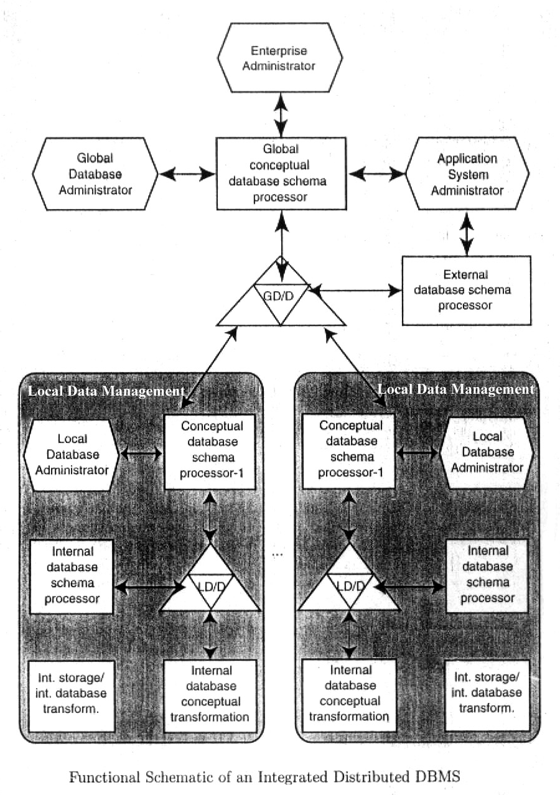
DISTRIBUTED DBMS ARCHITECTURE PEER-TO-PEER DISTRIBUTED SYSTEMS
In these case, the ANSI/SPARC model is extended by the addition of global directory / dictionary (GD/D) to permits the required global mappings. The local mappings are still performed by local directory / dictionary (LD/D). The local database management components are integrated by means of global DBMS functions. Local conceptual schemas are mappings of global schema onto each site.
‹#›

Slide 127
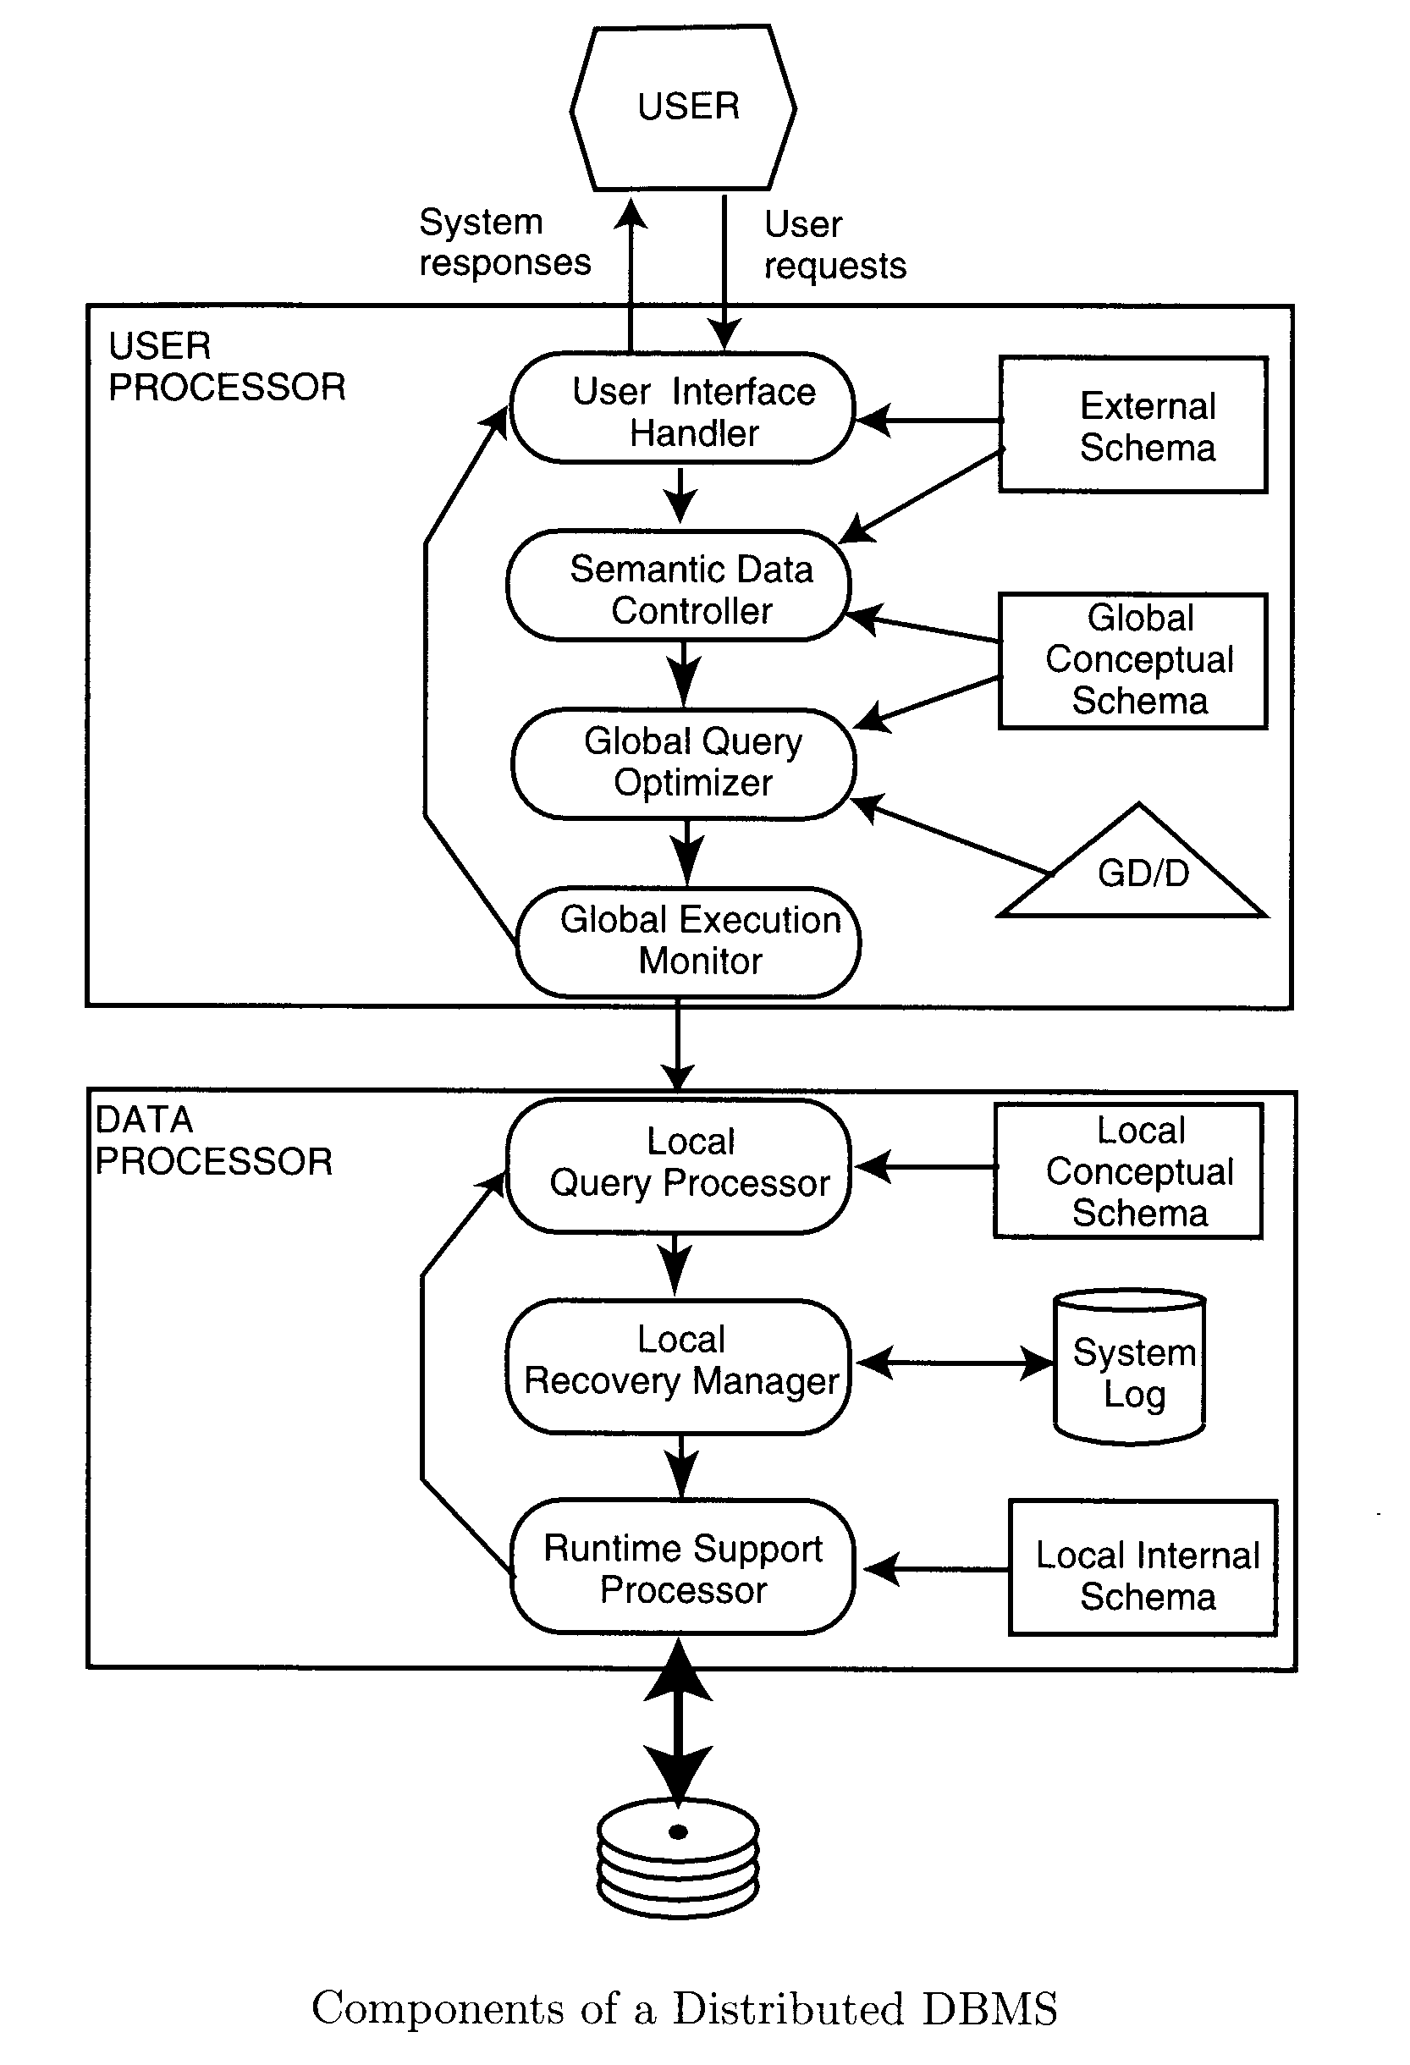
DISTRIBUTED DBMS ARCHITECTURE PEER-TO-PEER DISTRIBUTED SYSTEMS
The detailed components of a distributed DBMS.
Two major components:
user processor
data processor
‹#›

Slide 128
DISTRIBUTED DBMS ARCHITECTURE PEER-TO-PEER DISTRIBUTED SYSTEMS
User processor
user interface handler - is responsible for interpreting user commands as they come in, and formatting the result data as it is sent to the user,
semantic data controller - uses the integrity constraints and authorizations that are defined as part of the global conceptual schema to check if the user query can be processed,
global query optimizer and decomposer - determines an execution strategy to minimize a cost function, and translates the global queries in local ones using the global and local conceptual schemas as well as global directory,
distributed execution monitor - coordinates the distributed execution of the user request.
‹#›

Slide 129
DISTRIBUTED DBMS ARCHITECTURE PEER-TO-PEER DISTRIBUTED SYSTEMS
Data processor
local query optimizer - is responsible for choosing the best access path to access any data item,
local recovery manager - is responsible for making sure that the local database remains consistent even when failures occur,
run-time support processor - physically accesses the database according to the physical commands in the schedule generated by the query optimizer. This is the interface to the operating system and contains the database buffer (or cache) manager, which is responsible for maintaining the main memory buffers and managing the data accesses.
‹#›

Slide 130
Peer-to-Peer Distributed Systems
Schemas Present
Individual internal schema definition at each site, local internal schema
Enterprise view of data is described the global conceptual schema.
Local organization of data at each site is describe in the local conceptual schema.
User applications and user access to the database is supported by external schemas.
Local conceptual schemas are mappings of the global schema onto each site.
Databases are typically designed in a top-down fashion, and, therefore all external view definitions are made globally.
Major Components of a Peer-to-Peer System
User Processor
Data processor

Slide 131
Peer-to-Peer Distributed Systems
User Processor
User-interface handler
responsible for interpreting user commands, and formatting the result data
Semantic data controller
checks if the user query can be processed.
Global Query optimizer and decomposer
determines an execution strategy
Translates global queries into local one.
Distributed execution
Coordinates the distributed execution of the user request
Data processor
Local query optimizer
Acts as the access path selector
Responsible for choosing the best access path
Local Recovery Manager
Makes sure local database remains consistent
Run-time support processor
Is the interface to the operating system and contains the database buffer
Responsible for maintaining the main memory buffers and managing the data access.

Slide 132
Distributed Transaction Management:
Transaction:
Logical unit of work.
Distributed Transaction:- Transaction may access data at several sites.
Types Of Transaction:-
A local transaction accesses data in the single site at which the transaction was initiated.
A global transaction either accesses data in a site different from the one at which the transaction was initiated or accesses data in several different sites.
‹#›

Slide 133
Distributed Transactions
Transaction may access data at several sites.
Each site has a local transaction manager responsible for:
Maintaining a log for recovery purposes
Participating in coordinating the concurrent execution of the transactions executing at that site.
Each site has a transaction coordinator, which is responsible for:
Starting the execution of transactions that originate at the site.
Distributing sub transactions at appropriate sites for execution.
Coordinating the termination of each transaction that originates
at the site, which may result in the transaction being committed at
all sites or aborted at all sites.
‹#›

Slide 134
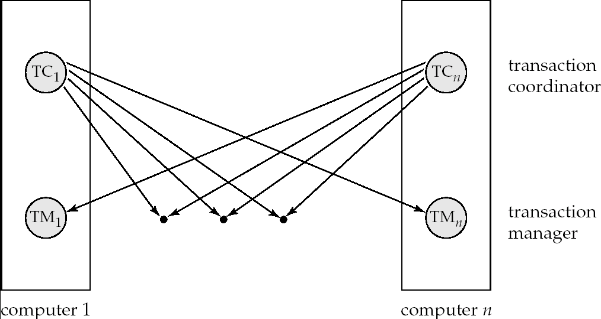
Transaction Management:
System Structure:-
‹#›

Slide 135
System Failure Modes
Failures unique to distributed systems:
Failure of a site.
Loss of massages
Handled by network transmission control protocols such as TCP-IP
Failure of a communication link
Handled by network protocols, by routing messages via alternative links
Notes:
‹#›

Slide 136
Commit Protocols:-
Commit protocols are used to ensure atomicity across sites
All the sites in which a transaction T executes must agree on the final outcome of the execution.
A transaction which executes at multiple sites must either be committed at all the sites, or aborted at all the sites.
Not acceptable to have a transaction committed at one site and aborted at another.
To ensure this property the transaction coordinator of T must execute commit Protocol.
The two-phase commit (2PC) protocol is widely used .
The three-phase commit (3PC) protocol is more complicated and more
expensive, but avoids some drawbacks of two-phase commit protocol. This protocol is not used in practice
‹#›

Slide 137
Two Phase Commit Protocol (2PC)
Assumes fail-stop model – failed sites simply stop working, and do not cause any other harm, such as sending incorrect messages to other sites.
Execution of the protocol is initiated by the coordinator after the last step of the transaction has been reached.
The protocol involves all the local sites at which the transaction executed
Let T be a transaction initiated at site S_{i}, and let the transaction coordinator at S_{i} be C_{i}
Notes:
‹#›

Slide 138
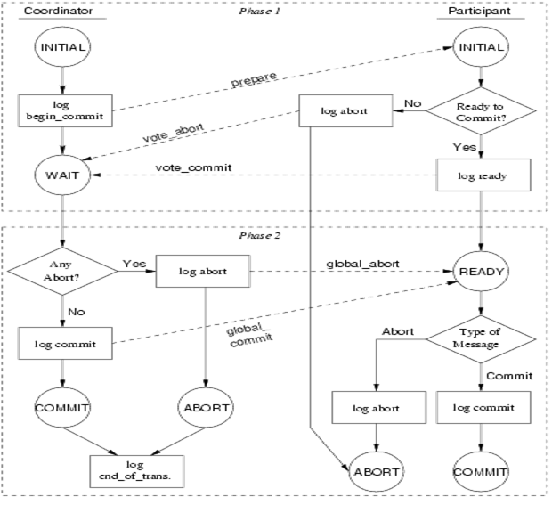
Two Phase Commit Protocol (2PC):
Assumes fail-stop model.
Working Of 2PC:-
‹#›

Slide 139
2PC cont…………….
When transaction T completes its execution then coordinator starts 2PC.
Let T be a transaction initiated at site S_{i}, and let the transaction coordinator at S_{i} be C_{i}
Phase 1:- PREPARE Phase
Coordinator asks all participants to prepare to commit transaction T_{i}.
C_{i} adds the records <prepare T> to the log and forces log to stable
storage .
sends prepare T messages to all sites where T executed
Upon receiving message, transaction manager at site determines if it can commit the transaction
if not: add a record <no T> to the log and send abort T message to Ci
if the transaction can be committed, then:
add the record <ready T> to the log
force all records for T to stable storage
send ready T message to Ci
‹#›

Slide 140
Phase 2: Decision Making Phase
T can be committed if C_{i} received a ready T message from all the participating sites otherwise T must be aborted.
Coordinator adds a decision record, <commit T> or <abort T>, to the log .
Coordinator sends a message to each participant informing it of the decision (commit or abort)
Participants take appropriate action locally.
Global Commit Rule:-
The Coordinator aborts a transaction if and if only if at least one participant votes to abort it.
The Coordinator Commits a transaction if and if only if all of the participant votes to Commit it.
‹#›

Slide 141
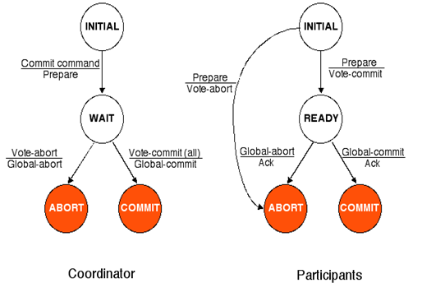
State transition in Two Phase Commit
‹#›

Slide 142
Handling of Failures in Two phase commit Protocol(Recovery):-
Failure of Participating Site:-
The log contains a <commit T> record. Then site Executes redo(T).
The log contains a <abort T> record. Then site Executes undo(T).
The log contains a <ready T> record then site consult to coordinator by using query status T message and takes decision.
‹#›

Slide 143
Failure of Coordinator:-
If an active site contains a <commit T> record in log then T must be committed.
If an active site contains a <abort T> record in log then T must be committed
If active site does not contain <ready T> record in its log then T must be aborted.
If active site contain <ready T> record in its log but no additional control record then T must wait until the coordinator recovers.
Disadvantages:-
Major disadvantages of the 2PC is that coordinator failure may
result in blocking of participating site.
‹#›

Slide 144
Handling of Failures - Network Partition
If the coordinator and all its participants remain in one partition, the failure has no effect on the commit protocol.
If the coordinator and its participants belong to several partitions:
Sites that are not in the partition containing the coordinator think the coordinator has failed, and execute the protocol to deal with failure of the coordinator.
No harm results, but sites may still have to wait for decision from coordinator.
The coordinator and the sites are in the same partition as the coordinator think that the sites in the other partition have failed, and follow the usual commit protocol.
Again, no harm results
‹#›

Slide 145
Recovery and Concurrency Control
In-doubt transactions have a <ready T>, but neither a <commit T>, nor an <abort T> log record.
The recovering site must determine the commit-abort status of such transactions by contacting other sites; this can slow and potentially block recovery.
Recovery algorithms can note lock information in the log.
Instead of <ready T>, write out <ready T, L> L = list of locks held by T when the log is written (read locks can be omitted).
For every in-doubt transaction T, all the locks noted in the <ready T, L> log record are reacquired.
After lock reacquisition, transaction processing can resume; the commit or rollback of in-doubt transactions is performed concurrently with the execution of new transactions.
‹#›

Slide 146
Three Phase Commit (3PC)
Assumptions:
No network partitioning
At any point, at least one site must be up.
At most K sites (participants as well as coordinator) can fail
Phase 1: Obtaining Preliminary Decision: Identical to 2PC Phase 1.
Every site is ready to commit if instructed to do so
Phase 2 of 2PC is split into 2 phases, Phase 2 and Phase 3 of 3PC
In phase 2 coordinator makes a decision as in 2PC (called the pre-commit decision) and records it in multiple (at least K) sites
In phase 3, coordinator sends commit/abort message to all participating sites,
Under 3PC, knowledge of pre-commit decision can be used to commit despite coordinator failure
Avoids blocking problem as long as < K sites fail
Drawbacks:
higher overheads
assumptions may not be satisfied in practice
‹#›

Slide 147
Concurrency Control in Distributed Databases
‹#›

Slide 148
Concurrency Control
Modify concurrency control schemes for use in distributed environment.
We assume that each site participates in the execution of a commit protocol to ensure global transaction atomicity.
We assume all replicas of any item are updated
Will see how to relax this in case of site failures later
‹#›

Slide 149
Single-Lock-Manager Approach
System maintains a single lock manager that resides in a single chosen site, say S_{i}
When a transaction needs to lock a data item, it sends a lock request to S_{i} and lock manager determines whether the lock can be granted immediately
If yes, lock manager sends a message to the site which initiated the request
If no, request is delayed until it can be granted, at which time a message is sent to the initiating site
‹#›

Slide 150
Single-Lock-Manager Approach (Cont.)
The transaction can read the data item from any one of the sites at which a replica of the data item resides.
Writes must be performed on all replicas of a data item
Advantages of scheme:
Simple implementation
Simple deadlock handling
Disadvantages of scheme are:
Bottleneck: lock manager site becomes a bottleneck
Vulnerability: system is vulnerable to lock manager site failure.
‹#›

Slide 151
Distributed Lock Manager
In this approach, functionality of locking is implemented by lock managers at each site
Lock managers control access to local data items
But special protocols may be used for replicas
Advantage: work is distributed and can be made robust to failures
Disadvantage: deadlock detection is more complicated
Lock managers cooperate for deadlock detection
Several variants of this approach
Primary copy
Majority protocol
Biased protocol
Quorum consensus
‹#›

Slide 152
Primary Copy
Choose one replica of data item to be the primary copy.
Site containing the replica is called the primary site for that data item
Different data items can have different primary sites
When a transaction needs to lock a data item Q, it requests a lock at the primary site of Q.
Implicitly gets lock on all replicas of the data item
Benefit
Concurrency control for replicated data handled similarly to unreplicated data - simple implementation.
Drawback
If the primary site of Q fails, Q is inaccessible even though other sites containing a replica may be accessible.
‹#›

Slide 153
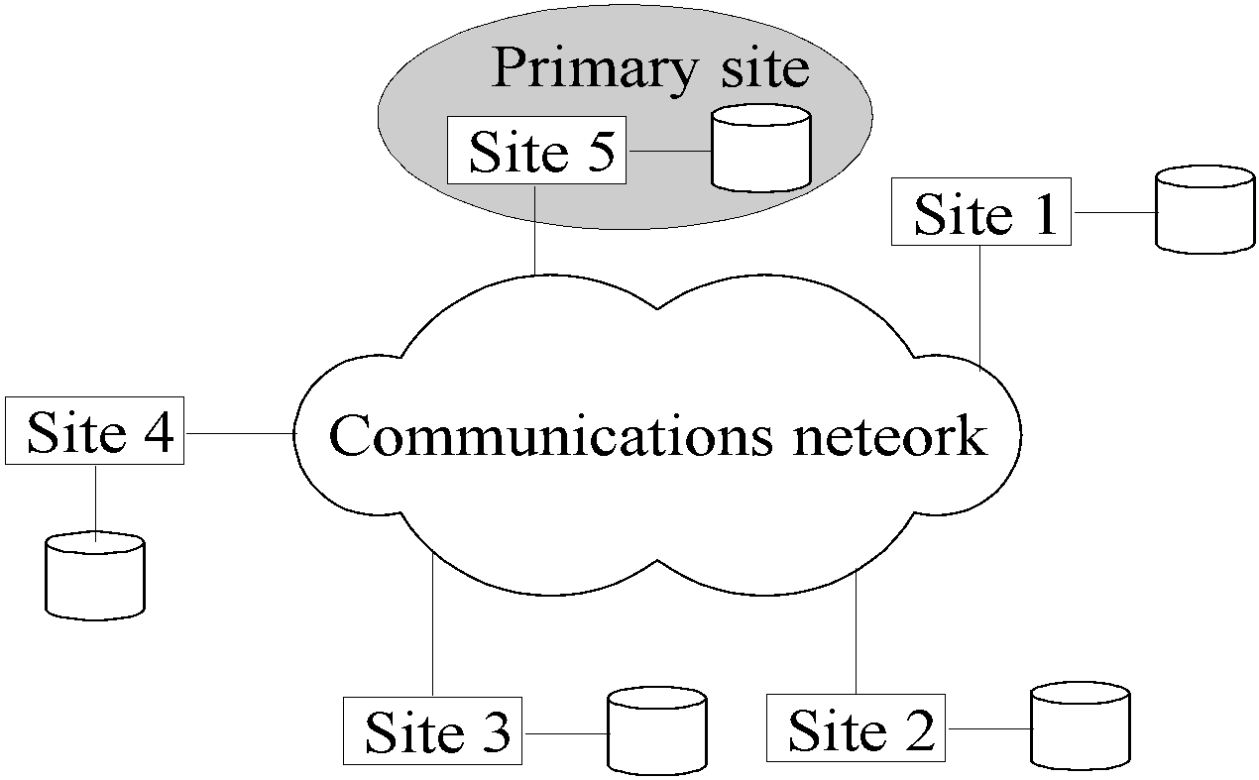

Slide 154
Majority Protocol
Local lock manager at each site administers lock and unlock requests for data items stored at that site.
When a transaction wishes to lock an unreplicated data item Q residing at site S_{i}, a message is sent to S_{i} ‘s lock manager.
If Q is locked in an incompatible mode, then the request is delayed until it can be granted.
When the lock request can be granted, the lock manager sends a message back to the initiator indicating that the lock request has been granted.
‹#›

Slide 155
Majority Protocol (Cont.)
In case of replicated data
If Q is replicated at n sites, then a lock request message must be sent to more than half of the n sites in which Q is stored.
The transaction does not operate on Q until it has obtained a lock on a majority of the replicas of Q.
When writing the data item, transaction performs writes on all replicas.
Benefit
Can be used even when some sites are unavailable
Drawback
Requires 2(n/2 + 1) messages for handling lock requests, and (n/2 + 1) messages for handling unlock requests.
Potential for deadlock even with single item - e.g., each of 3 transactions may have locks on 1/3rd of the replicas of a data.
‹#›

Slide 156
Biased Protocol
Local lock manager at each site as in majority protocol, however, requests for shared locks are handled differently than requests for exclusive locks.
Shared locks. When a transaction needs to lock data item Q, it simply requests a lock on Q from the lock manager at one site containing a replica of Q.
Exclusive locks. When transaction needs to lock data item Q, it requests a lock on Q from the lock manager at all sites containing a replica of Q.
Advantage - imposes less overhead on read operations.
Disadvantage - additional overhead on writes
‹#›

Slide 157
Quorum Consensus Protocol
A generalization of both majority and biased protocols
Each site is assigned a weight.
Let S be the total of all site weights
Choose two values read quorum Q_{r} and write quorum Q_{w}
Such that Q_{r} + Q_{w} > S and 2 * Q_{w} > S
Quorums can be chosen (and S computed) separately for each item
Each read must lock enough replicas that the sum of the site weights is >= Q_{r}
Each write must lock enough replicas that the sum of the site weights is >= Q_{w}
‹#›

Slide 158
Query Processing
high level user query
query
processor
low level data manipulation
commands

Slide 159
Distributed Query Processing Methodology
Calculus Query on Distributed
Relations
Query
Decomposition
GLOBAL
SCHEMA
Algebraic Query on Distributed
Relations
CONTROL
SITE
FRAGMENT
SCHEMA
Data
Localization
Fragment Query
Global
Optimization
STATS ON
FRAGMENTS
Optimized Fragment Query
with Communication Operations
LOCAL
SITES
Local
Optimization
LOCAL
SCHEMAS
Optimized Local
Queries

Slide 160
Query Decomposition
The first layer decomposes the query in an algebraic query over global relations.
In this process, syntactic and semantic analyses are performed over the submitted query.
The query is simplified and rewritten in an algebraic form. Information about data distribution are not used in this layer

Slide 161
Data Localization
The data localization layer has as goal to locate query data by using information about data distribution (fragmentation and allocation of fragments among the nodes).
This layer determines the fragments that are involved in the query, and replaces the references to the global view by references to fragments in the algebraic query.
This replacement can be performed automatically when the fragmentation design follows correction rules such as the reconstruction rule (the global database can be reconstructed from its fragments)

Slide 162
Global Optimization
The global optimization layer tries to find a near to optimal strategy (or plan) to execute the global query.
The optimization is performed, in general, by minimizing a cost function. The cost function is usually a combination of CPU, communication and I/O costs.
To databases distributed in slow networks, the communication cost must be the most important factor in the cost function.

Slide 163
Local Optimization
After global optimization of the global query, sub-queries are generated and sent to the remote sites.
Each sub-query executed in a given site is further optimized using the local site schema in the local optimization layer.
The results of the remote subqueries are processed by the DBMS according to the adopted strategy of final result composition.

Slide 164
Example
Find the names of employees other than J. Doe who worked on the CAD/CAM project for either one or two years.
SELECT ENAME
FROM PROJ, ASG, EMP
WHERE ASG.ENO=EMP.ENO
AND ASG.PNO=PROJ.PNO
AND ENAME≠“J. Doe”
AND PROJ.PNAME=“CAD/CAM”
AND (DUR=12 OR DUR=24)
Π_{ENAME}
Project
σ_{DUR=12 OR DUR=24}
σ_{PNAME=“CAD/CAM”}
Select
σ_{ENAME≠“J. DOE”}
_{PNO}
_{ENO}
Join
PROJ
ASG
EMP

Slide 165
Equivalent Query
Π_{ENAME}
σPNAME=“CAD/CAM” ∧(DUR=12 ∨ DUR=24) ∧ ENAME≠“J. DOE”
_{PNO ∧ENO}
×
ASG
PROJ
EMP

Slide 166
Restructuring
Π_{ENAME}
_{PNO}
Π_{PNO,ENAME}
_{ENO}
Π_{PNO}
Π_{PNO,ENO}
Π_{PNO,ENAME}
σ_{PNAME = "CAD/CAM"}
σ_{DUR =12 ∧ DUR=24}
σ_{ENAME ≠ "J. Doe"}
PROJ
ASG
EMP

Slide 167
Reduction for PHF
Reduction with selection
Relation R and F_{R}={R₁, R₂, …, R_{w}} where R_{j}=σ _{pj}(R)
σ _{pi}(R_{j})= φ if ∀x in R: ¬(p_{i}(x) ∧ p_{j}(x))
Example
SELECT *
FROM EMP
WHERE ENO=“E5”
σ _{ENO=“E5”}
σ _{ENO=“E5”}
∪
EMP₁
EMP₂
EMP₃
EMP₂

Slide 168
Reduction for PHF
Reduction with join
Possible if fragmentation is done on join attribute
Distribute join over union
(R₁ ∪ R₂) S ⇔ (R₁ S) ∪ (R₂ S)
Given R_{i} = σ_{pi}(R) and R_{j} = σ_{pj}(R)
R_{i} R_{j} = φ if ∀x in R_{i}, ∀y in R_{j}: ¬(p_{i}(x) ∧ p_{j}(y))

Slide 169
Reduction for PHF
Reduction with join - Example
Assume EMP is fragmented as before and
ASG₁: σ_{ENO ≤ "E3"}(ASG)
ASG₂: σ_{ENO > "E3"}(ASG)
Consider the query
SELECT*
FROM EMP, ASG
WHERE EMP.ENO=ASG.ENO
_{ENO}
∪
∪
EMP₁
EMP₂
EMP₃
ASG₁
ASG₂

Slide 170
Reduction for PHF
Reduction with join - Example
Distribute join over unions
Apply the reduction rule
∪
_{ENO}
_{ENO}
_{ENO}
EMP₁
ASG₁
EMP₂
ASG₂
EMP₃
ASG₂

Slide 171
Reduction for VF
Find useless (not empty) intermediate relations
Relation R defined over attributes A = {A₁, ..., A_{n}} vertically fragmented as R_{i} = Π_{A'} (R) where A' ⊆ A:
Π_{D,K}(R_{i}) is useless if the set of projection attributes D is not in A'
Example: EMP₁= Π_{ENO,ENAME} (EMP); EMP₂= Π_{ENO,TITLE} (EMP)
SELECT ENAME
FROM EMP
Π_{ENAME}
Π_{ENAME}
⇒
_{ENO}
EMP₁
EMP₂
EMP₁

Slide 172
Reduction for DHF
Generic query
_{ENO}
σ _{TITLE=“Mech. Eng.”}
∪
∪
ASG₁
ASG₂
EMP₁
EMP₂
Selections first
_{ENO}
∪
σ _{TITLE=“Mech. Eng.”}
ASG₁
ASG₂
EMP₂

Slide 173
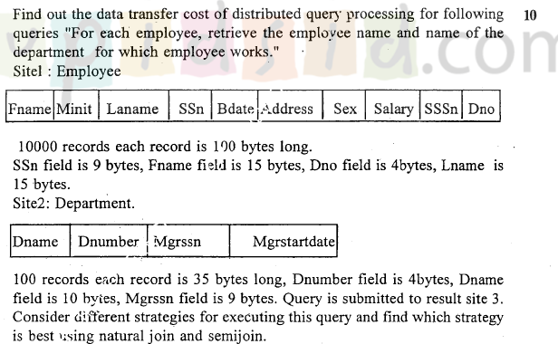

Slide 174

Query Processing in Distributed Databases
Cost of transferring data (files and results) over the network.
This cost is usually high so some optimization is necessary.
Example relations: Employee at site 1 and Department at Site 2
Employee at site 1. 10, 000 rows. Row size = 100 bytes. Table size = 10⁶ bytes.
Fname | Minit | Lname | SSN | Bdate | Address | Sex | Salary | Superssn | Dno
Department at Site 2. 100 rows. Row size = 35 bytes. Table size = 3500 bytes.
Dname | Dnumber | Mgrssn | Mgrstartdate
Q: For each employee, retrieve employee name and department nameWhere the employee works.
Q: Π_{Fname,Lname,Dname} (Employee _{Dno = Dnumber} Department)

Slide 175
cont… Query Processing In Distributed Databases
Factor which effects query processing
The cost of transferring data over the network.
Goal of query processing
The goal of reducing the amount of data transfer in choosing a distributed query execution strategy.
Eg : At site 1:
Employee
(Fname,Lname,SSN,Address,Superssn,Dno)
10,000 records each record is 100 bytes long
SSN field is 9 bytes long ,Fname field is 15bytes
Dno field is 4 bytes long, Lname field is 15 bytes long

Slide 176
cont… Query Processing In Distributed Databases
Site 2:
Department
(Dname,Dnumber,MGRSSN,MGRSTARTDATE)
100 records
Each record is 35 bytes long
Dnumber field is 4 bytes long,Dname field is 10 bytes
MGRSSN field is 9 bytes long
Suppose you ask a query
Q: For each employee, retrieve employee name and department name Where the employee works.
Q: Π_{Fname,Lname,Dname} (Employee _{Dno = Dnumber} Department)

Slide 177
cont… Query Processing In Distributed Databases
The result of this query will select 10,000 record assuming that
every employee is related to a department.
Each record in the query result will be of 40 bytes long.
This query is submitted at site 3 (result site)
There are three different strategies for executing this distributed query
1) Transfer both the employee and the department relations to the result site and form a join at site 3.In this case a total of 1,000,000+3500=1,003,500 bytes must be transferred .
2) Transfer the Employee to site 2, execute the join at site 2, and send the result to site 3.The size of the query is 40*10,000=400,000 bytes, so 400,000+1,000,000=1,400,000 bytes must be transferred.

Slide 178
cont… Query Processing In Distributed Databases
3) Transfer the Department relation to site 1,execute the join at site 1 and send the result to site 3.In this case 400,000+3500=403,500 bytes must be transferred.
To minimize the amount of data transfer we should use the strategy 3.
So we should select the strategy for which the data transfer is minimum.

Slide 179
Distributed Query Processing Using Semijoin
Goal: To reduce the number of tuples in a relation before transferring it to another site.
Eg: For Q (previous query)
1) Project the join attributes of Department at site 2, and transfer them to site 1
F= Pro _{Dnumber} (Department) whose size is 4* 100=400 bytes.
2) Join the transferred file with the Employee
relation at site 1, and transfer the required attributes from resulting file to site 2. For Q, we transfer
R= Pro _{Dno,Fname,Lname} (F join _{Dnumber=Dno} Employee) whose
size is 34*10000=3400 00bytes.
3) Execute the query by joining the transferred file R with Department , and present the result at site 2
Size=40*10000=400000. Total Transfer=340000+400000+400=740400.

Slide 180
Consider the query
Q’: For each department, retrieve the department name and the name of the department manager
Relational Algebra expression:
Π_{Fname,Lname,Dname} (Employee _{Mgrssn = SSN} Department)

Slide 181
Query Processing in Distributed Databases
The result of this query will have 100 tuples, assuming that every department has a manager, the execution strategies are:
Strategies:
Transfer Employee and Department to the result site and perorm the join at site 3. Total bytes transferred = 1,000,000 + 3500 = 1,003,500 bytes.
Transfer Employee to site 2, execute join at site 2 and send the result to site 3. Query result size = 40 * 100 = 4000 bytes. Total transfer size = 4000 + 1,000,000 = 1,004,000 bytes.
Transfer Department relation to site 1, execute join at site 1 and send the result to site 3. Total transfer size = 4000 + 3500 = 7500 bytes.

Slide 182
Query Processing in Distributed Databases
Preferred strategy: Chose strategy 3.
Now suppose the result site is 2. Possible strategies:
Possible strategies :
Transfer Employee relation to site 2, execute the query and present the result to the user at site 2. Total transfer size = 1,000,000 bytes for both queries Q and Q’.
Transfer Department relation to site 1, execute join at site 1 and send the result back to site 2. Total transfer size for Q = 400,000 + 3500 = 403,500 bytes and for Q’ = 4000 + 3500 = 7500 bytes.

Slide 183
cont.. Distributed Query Processing Using Semijoin
A semi join operation R Semijoin _{A=B} S where A and B are domain-compatible attributes of R and S, respectively, and produces the same result as the relational algebra expression Pro_{R} (Rjoin _{A=B} S).
In a distributed environment where R and S reside at different sites, the semijoin is typically implemented by first transferring F=Pro _{B} (S) to the site where R resides and then joining F with R.
Note that the semijoin operation is not commutative, that is
R semijoin S not equal to S semijoin R.

Slide 184
Semijoin Query Processing in Distributed Databases
Semijoin: Objective is to reduce the number of tuples in a relation before transferring it to another site.
Example execution of Q or Q’:
Project the join attributes of Department at site 2, and transfer them to site 1. For Q, 4 * 100 = 400 bytes are transferred and for Q’, 9 * 100 = 900 bytes are transferred.
Join the transferred file with the Employee relation at site 1, and transfer the required attributes from the resulting file to site 2. For Q, 34 * 10,000 = 340,000 bytes are transferred and for Q’, 39 * 100 = 3900 bytes are transferred.
Execute the query by joining the transferred file with Department and present the result to the user at site 2.

Slide 185
Query and Update Decomposition
The user must also maintain consistency of replicated data items when updating a DDBMS with no replication transparency.
The DDBMS supports full distribution, fragmentation and replication transparency and allows the user to specify a query or update request on the schema as though the DBMS were centralized.
For queries the query decomposition module must break up or decompose a query into subqueries that can be executed at the individual sites and combining the results of the subqueries to form the query result.

Slide 186
CONT… Query and Update Decomposition
To determine which replicas include the data items referenced in a query, the DDBMS refers to the fragmentation, replication, and distribution information stored in the DDBMS catalog.
For vertical fragmentation the attribute list for each fragment is kept in catalog.
For horizontal fragmentation, a condition, some times called a guard, is kept for each fragment.
Guard is a selection condition which specifies which tuples exist in the fragment.

Slide 187
cont… Query and Update Decomposition
Eg: A user requests to insert a new tuple
<‘Alex’, ‘B’, ,’Coleman’, ‘348889793’,’22-apr-64’, ‘3306 sandstone, houston, TX’, M,33000,’234412414’,4> would be decomposed into two insert requests.
The first insert inserts the preceding tuple in the Employee fragment at site1, and the second inserts the projected tuple
<‘Alex’, ’B’, ‘Coleman’, ‘348889793’, 33000, ’234412414’, 4> in the Empd4 fragment at site 3 for easy retrieval.
For query decomposition ,the DDBMS can determine which fragments may contain the required tuples by comparing the query condition with the guard conditions.

